Slide 1
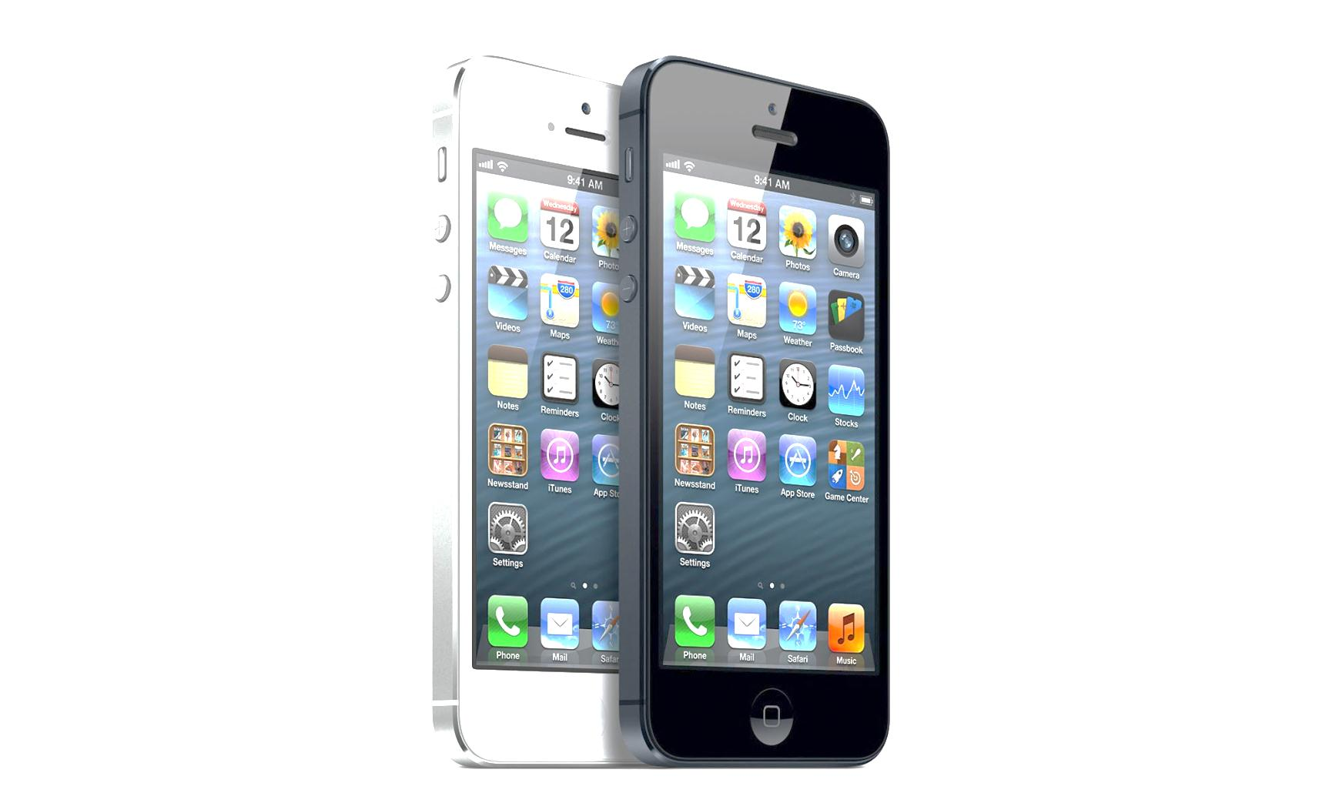
Apple IPhone basics
Apple IPhone information
By: Mac, Harley, Tristan

Slide 2


App Store
The app store give you access to over 500,000 apps aside form all the apps you already have, you will find everything for games, apps can entertain you with movies, games and other great apps. The app store cost lots of money and still find thousands of more apps and you can download things for just
ninety-nine cents.

Slide 3

Prices for IPhones
No Contracts
-649$16GB
-749$34GB
-849$64GB
Under Contracts
199 $ 16GB
299$34GB
399$64GB

Slide 4
Personalizing your IPhone
Managing your apps and notifications
When you collect more apps you might start to think to organize them by organize them by alphabetical order. When notification on your iPhone, your IPhone

